Slide 1

Intro to Concurrency
CS532: OS Foundations
PASS
Lab Assignment
Email: chitram2@pdx.edu & ramya3@pdx.edu

Slide 2
Instructions: Make a copy of this document, move your copy to your submissions folder and fill the document with your responses. Use the space on each slide to show your responses, and add additional slides as needed.
When ready for grading: complete the lab assignment submission form and include a link to your filled document
PASS

Slide 3
helloT.c
Find the helloT.c program linked from the unit course plan document. Read and understand the source code. Read the man pages for all of the pthreads API calls used in the program so that you fully understand the program.
Build and run helloT and confirm that the output is similar to what is described in the source code.
PASS

Slide 4
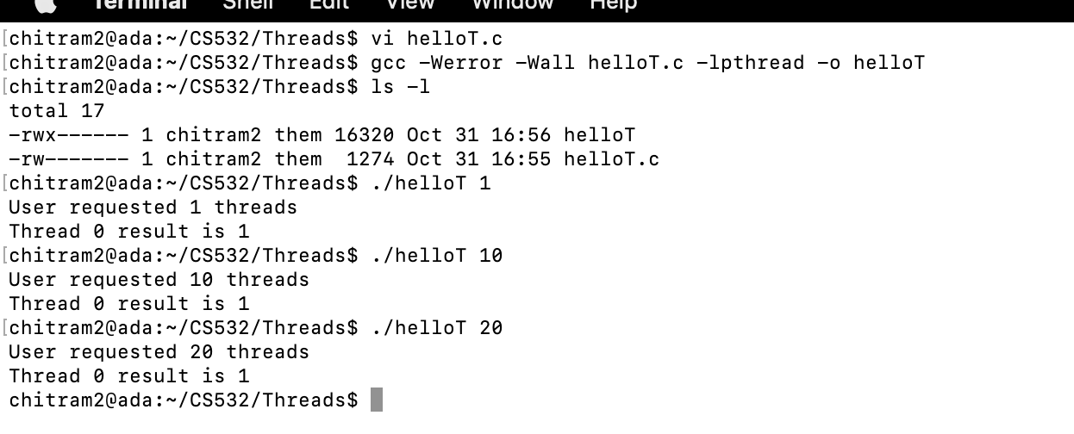

Slide 5
1. Modify your copy of helloT.c so that it creates the correct number of threads and that each thread computes its own unique factorial. Test the code with various input values.
Name your fixed version helloT2.c, upload it to your submissions folder and provide a link to it here (the link below is incorrect and must be changed to link to your helloT2.c program)
https://drive.google.com/drive/folders/1JPRpFNPYjbimCLBRJLX6H8RspDTzVBXW
[Optional] This is extremely close, well done! This is a nitpick, not required to fix but recommended because it is technically causing you to be short one thread: Zero indexing is expected, so: thread_args[i] = i + 1; so i+1 should be just i
PASS

Slide 6
#include <pthread.h>
#include <stdio.h>
#include <stdlib.h>
#include <unistd.h>
#define MAXTHREADS 50
#define SLEEPTIME 5
volatile unsigned long long Total = 0ULL;
pthread_mutex_t mVar=PTHREAD_MUTEX_INITIALIZER;
void *Factorial(void *tidptr)
{
sleep(SLEEPTIME);
int tid = * ((int*) tidptr);
if (tid > 20) {
fprintf(stderr, "ERROR: thread %d exit to avoid long long overflow\n", tid);
return NULL;
}
unsigned long long factorial = 1;
for (int j = 1; j <= tid; j++) {
pthread_mutex_lock(&mVar);
factorial *= j;
pthread_mutex_unlock(&mVar);
}
printf("Thread %d result is %llu\n", tid, factorial);
return NULL;
}
int main(int argc, char *argv[])
{
if (argc != 2) {
fprintf(stderr, "USAGE: helloT <nthreads>\n");
exit(-1); }

Slide 7
int nthreads = atoi(argv[1]);
if (nthreads < 1) {
fprintf(stderr, "ERROR: numthreads must be >= 1\n");
exit(-1);
}
printf("User requested %d threads\n", nthreads);
int rc;
pthread_t t[nthreads];
int tids[MAXTHREADS];
for (int i = 0; i < nthreads; i++) {
tids[i] = i+1;
rc = pthread_create(&t[i], NULL, Factorial, (void *) &tids[i]);
if (rc){
printf("ERROR; return code from pthread_create() is %d\n", rc);
exit(-1);
}
} for (int i = 0; i < nthreads; i++) {
rc = pthread_join(t[i], NULL);
if (rc != 0) {
fprintf(stderr, "ERROR joining with thread %d (error==%d)\n", tids[i], rc);
exit(-1);
}
}
exit(0);
}

Slide 8
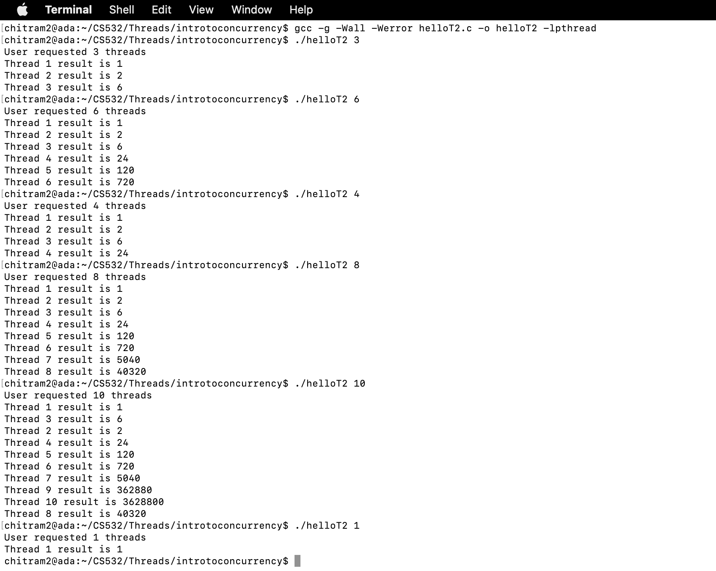

Slide 9
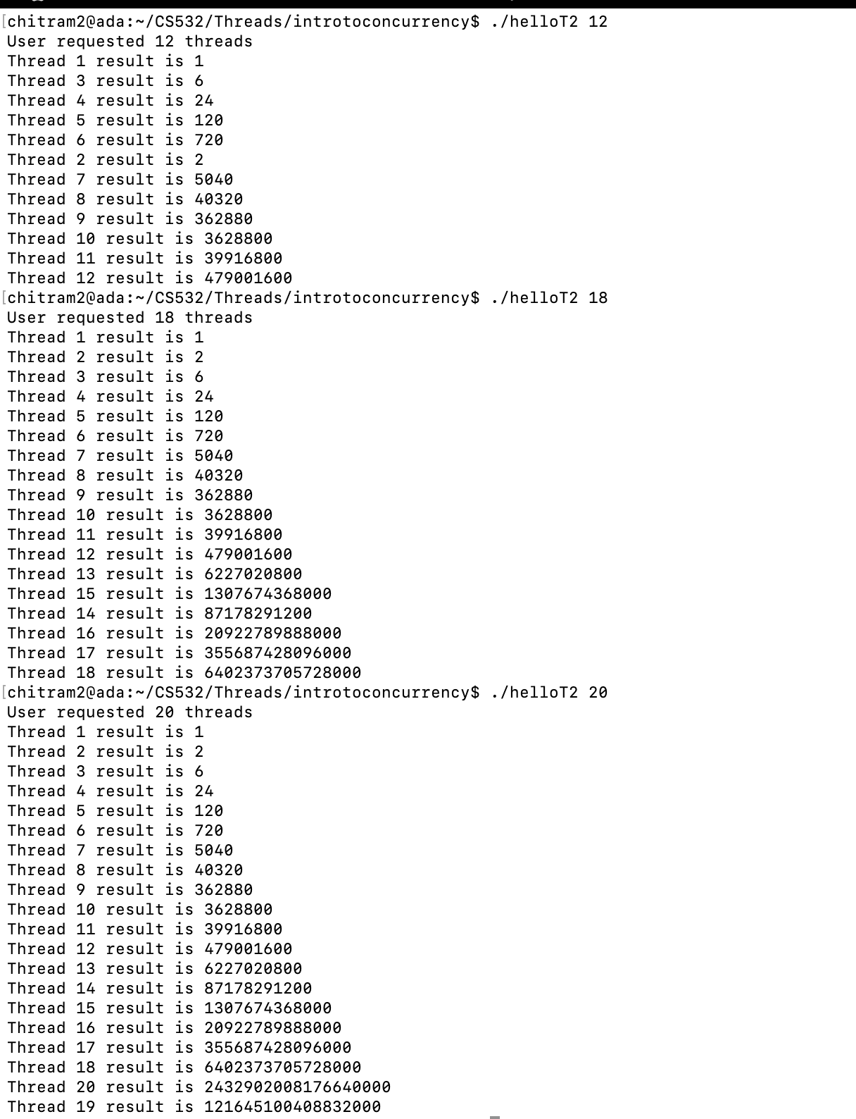

Slide 10
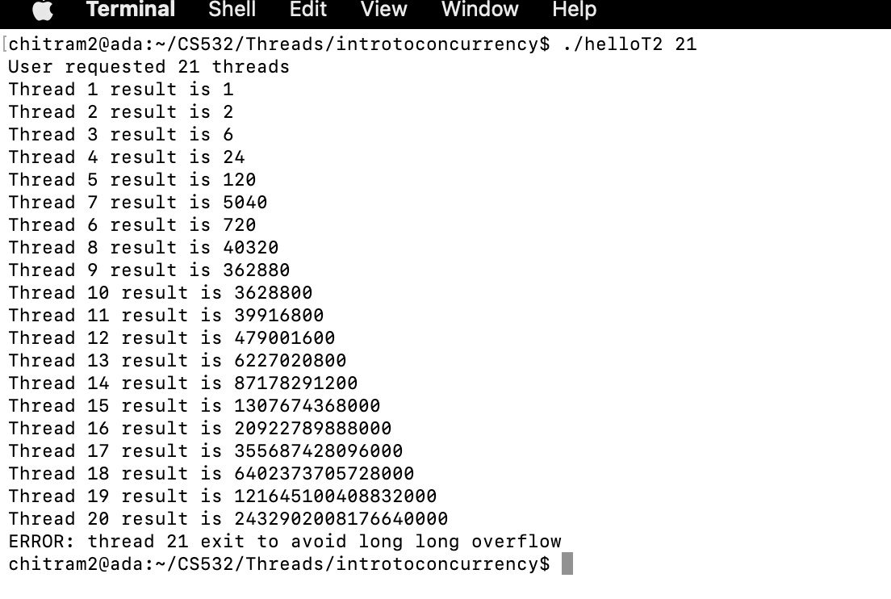

Slide 11
2. test your helloT program by running the following sequence of commands on your linux system:
rm -f helloT2_out.txt date > helloT2_out.txt
echo ./helloT2 1 >> helloT2_out.txt
./helloT2 1 >> helloT2_out.txt
echo ./helloT2 5 >> helloT2_out.txt
./helloT2 5 >> helloT2_out.txt
echo ./helloT2 15 >> helloT2_out.txt
./helloT2 15 >> helloT2_out.txt
echo ./helloT2 25 >> helloT2_out.txt
./helloT2 25 >> helloT2_out.txt
date >> helloT2_out.txt
Inspect the helloT2_out.txt file to make sure that the program is running correctly. Upload your helloT2_out.txt file to your submission folder and provide a link to it here: link
PASS

Slide 12
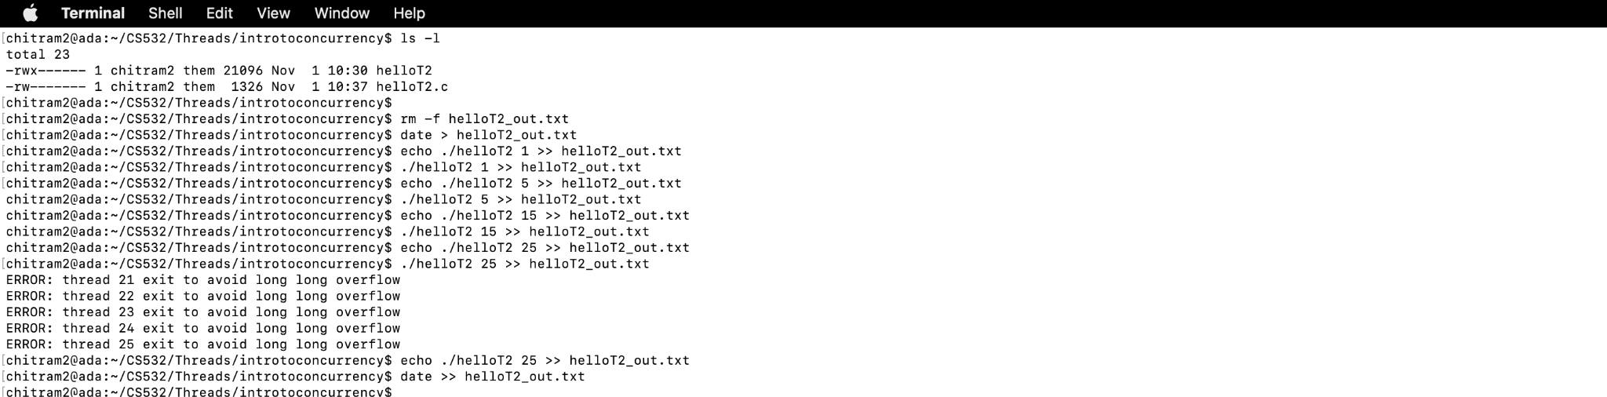

Slide 13
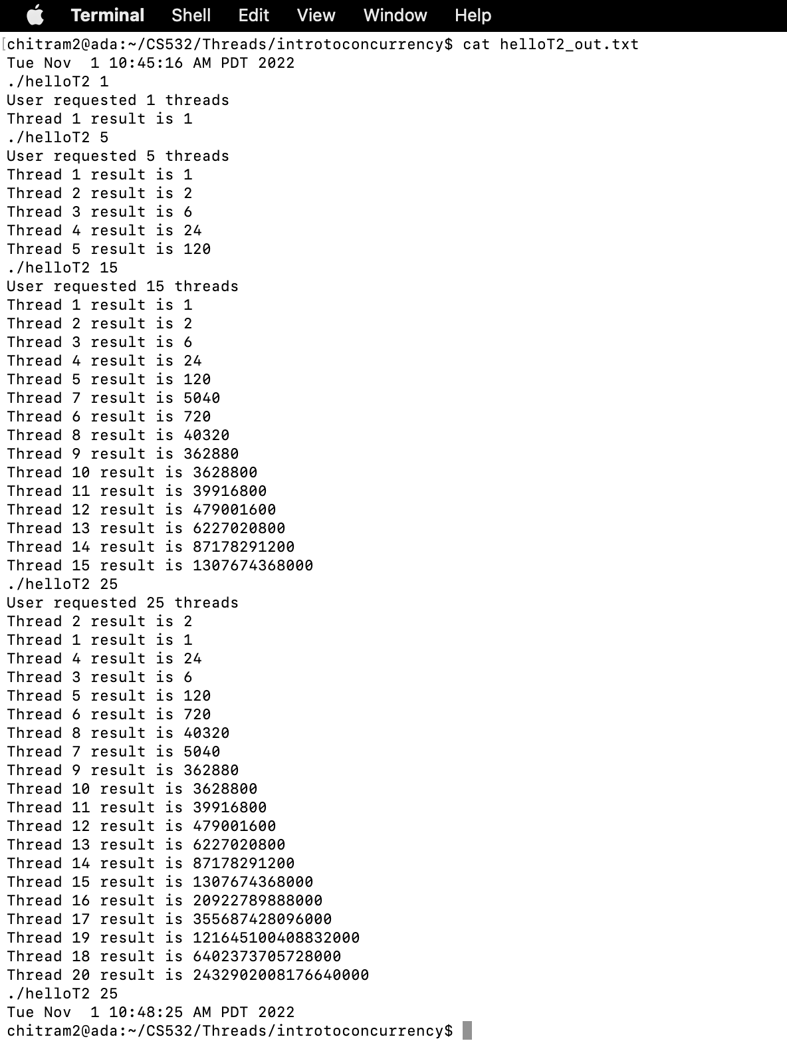

Slide 14
3. Were any parts of this assignment particularly difficult for you? If so, describe the most difficult part of the assignment, for example, the part that required the most effort for you.
In this assignment, first question to modify helloT program and virtualization memory management assignments were required to put the most effort.
PASS

Slide 15
4. Before this assignment had you any previous experience writing concurrent software? If yes, then briefly describe your previous experiences.
No, We do not have previous experience to write concurrent software.
PASS

